Slide 1
WINSS
Empowering Vulnerable Populations Through Self-Sufficiency

Slide 2
Who is WINSS?

Slide 3
WHO DOES WINSS HELP?
Rwanda, Uganda, South Sudanese Refugees, Women & Children, Aborigines

Slide 4
WHAT DOES WINSS DO?
The mission of WINSS is to empower vulnerable populations in East Africa through interconnected projects that promote self-sufficiency in three ways: education and awareness, skills training opportunities, and micro-business development for schools and for communities.

Slide 5
INTERCONNECTED 4-FOLD MISSION
Education
Community involvement
Government support
Cultural Change – grass roots
Education and training
Reusable sanitary pads
Skills Training
Overcome mental issues from genocide
Support micro-businesses
Build community support
Effectively use local resources
Micro-business
School run businesses to cover school fees and feed students
Life skills education
Trades experience
Expand their world
Domestic markets
International Markets

Slide 6
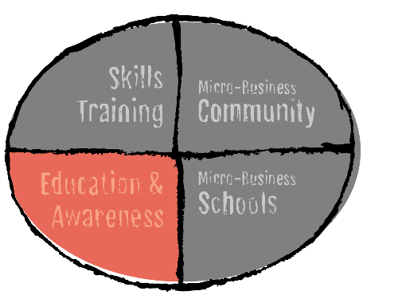
Education & Awareness
By teaching boys and girls from a very young age, we are able to begin breaking the vicious cycle of poverty and poor educational opportunities for girls. Women are able to heal from the physical and mental health traumas of the FGM procedures. Healthy mothers can rear healthy and hopeful children.
Female genital mutilation is a widespread practice in many places in the world, especially in East Africa. The oppression cycle to women starts when the girls begin their menstrual cycles. These girls have few to no resources to take care of their feminine hygiene, so it is embarrassing for them to leave home; girls stay home from school, which means that they are continuously missing 25% of their school attendance. They fall behind in their education, putting them at a disadvantage to their male peers and in a very vulnerable position financially. Their self-sufficiency is compromised, which combined with cultural biases forces the girls and their families to see marriage as the only hope for their daughters’ futures. Unfortunately, males are taught that a “good” wife needs to have been circumcised, so the girls and their families perpetuate the vicious cycle. Unfortunately, there is a large percentage of men who leave their wives and children after they see they cannot support them, or just because they want to avoid the responsibility. Thus women are left with little to no education, no means of self-sufficiency, and holding the responsibility to provide for themselves and their children. And the cycle continues.

Slide 7
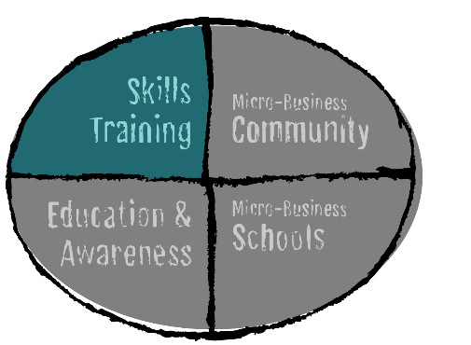
Skills Training
We empower men and women to learn life skills that will improve their quality of life. We teach them to “learn how to learn,” or become self-learners, outside a of the classroom setting.
Rwanda is still working to recover from the massive 1994 genocide. Sudanese refugees are struggling to be allowed to work and be self-reliant. The WINSS mission is to provide tools to school-age children, teachers, parents and the community at large to develop self-sufficiency opportunities to support themselves and their families.

Slide 8
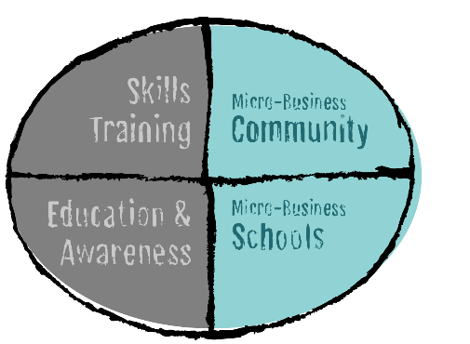
Micro-Business in Schools
Caring for the chickens helps teach the children basic skills to prepare them to care for their own families. The eggs will provide food for the school children, and excess eggs can be sold so that the schools can use the funds to lower school fees.
There are no public schools in Rwanda, Uganda or Kenya, so the schools have to be self-financed. The average tuition is $20USD/month, yet most adults only earn as much as $2/day making it financially impossible to educate all of their children. Usually the oldest child receives an education with preference given to the male children.

Slide 9
Micro-Business in the Community
People receive employment relevant to their community, and they are able to practice the skills they learn during their skills training. People will be accountable for their own investment and success as they will be required to pay back a small percentage of the initial investment from the WINSS Foundation. Most importantly, people will have a renewed sense of hope, encouragement, and opportunity to see their business ideas take shape. As they teach the upcoming generations they will break the cycle of hopelessness and extreme poverty.
The focus for the micro-businesses project area is to provide resources to East African start-ups so that they can begin a small business venture that on their own they can’t afford. The idea is to provide the resources, not the money, to ensure the funds are indeed invested in the business.

Slide 10
HOW WILL WINSS DO IT?
PHASE 1 – By December 31, 2019, WINSS will have established a 6-month pilot program for one community in each self-sufficiency area.
Phase 2 – By December 31, 2020, WINSS will have established a sustainable program in one community in each self-sufficiency area; a second set of pilot programs.
The purpose is the same as the analogy that states, “If you give a man a fish, he eats for a day. If you teach a man to fish, he will eat forever.”

Slide 11
OUR VISION: Education & Awareness
Hold semi-annual meetings with government leaders in Rwanda, Uganda, and Kenya and establish collaboration plans
Develop training showing that FGM is not necessary for a happy life
Present training to 1,000 people

Slide 12
OUR VISION: Skills Training
Develop a garden for yield course and teach the children, teachers, and parents
Develop a training program in three strategic growth areas: sewing, high yield gardening, international markets. Present it to 6 different communities
Train 20 leaders who will sustain a training program that pays it forward.

Slide 13
OUR VISION: Micro-Businesses in Schools
Purchase materials and build one chicken coop
Purchase 20 chickens and feed for 6 months
Purchase vegetable seeds and fertilizer and plant a garden

Slide 14
OUR VISION: Micro-Businesses in the Community
Purchase one industrial size peanut grinder
Purchase 5 sewing machines and fabric for reusable sanitary pads. Make 500 kits.
Purchase Materials and build one chicken cook in one target community
Purchase 20 chickens and feed for 6 months
Develop an international marketing plan
Expand WINSS website to include marketing plan

Slide 15
HOW CAN YOU HELP?
Self-sufficiency for the future starts today. By helping to provide funds, volunteering or purchasing art work at our humanitarian Art Shows, you give opportunities for success to those who are stuck in the cycle of poverty

Slide 16
HELP WITH: Education & Awareness
We use the money from your donations and purchases to design and deliver specific information in the schools to teach boys and girls, male and female teachers, and parents that FGM is not necessary; that they can live happy lives without FGM. We train the teachers and parents so that they in turn can teach others in their communities: a grassroots approach. In 2019 and 2020 we will continue to reach the countries’ governments, as many of them also want to eradicate FGM.

Slide 17
HELP WITH: Skill Training
WINSS goal is to develop a group of leaders who will sustain a program that pays it forward. You can volunteer your time to teach and provide skilled training in areas relevant to the people’s immediate physical and financial needs: hygiene and sanitation, food preparation, sewing, gardening, navigating the internet and computer skills, how to generate their own electricity, and other area-specific needs.

Slide 18
HELP WITH: Micro-Businesses in Schools
Your donation will be used to purchase chickens and materials to build a chicken coop to protect the chickens from wild dogs and other predators.

Slide 19
HELP WITH: Micro-Businesses in the Community
The money WINSS is able to raise from donations and product sales will be used to purchase equipment and materials for a peanut grinder, 3 sewing machines, and a chicken coop with chickens.

Slide 20
YOUR STORY
You can make a video telling the children about your life: your childhood, your challenges, your dreams, your efforts, your schooling, your work, your successes & disappointments. They know there is a bigger more prosperous world out there, and yet feel that they are forgotten, that they will never get to enjoy what we have. Let them know you care, and give them hope for a brighter future.

